Slide 1
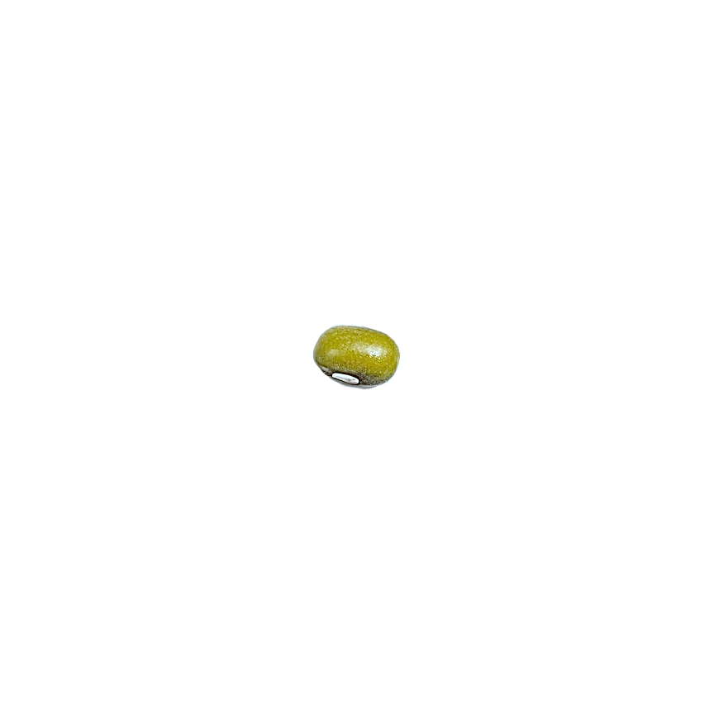
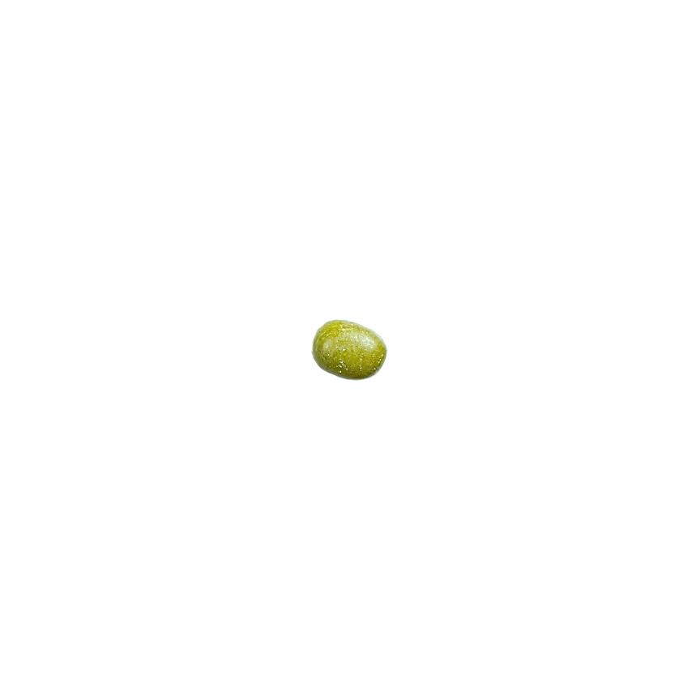
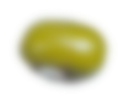
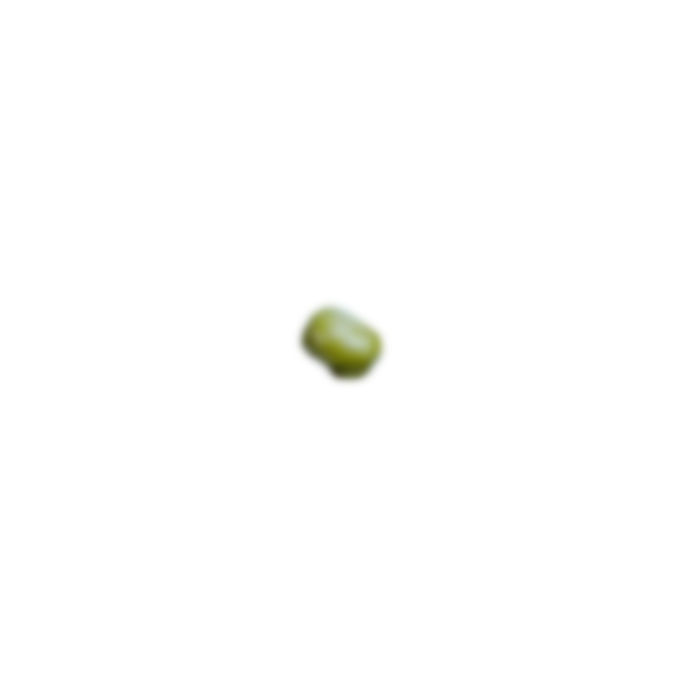
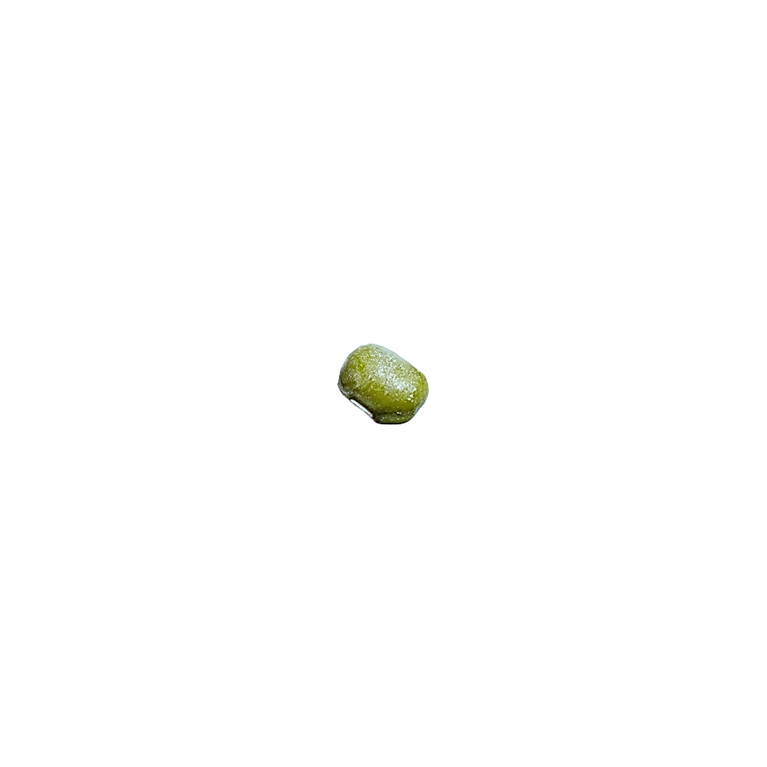

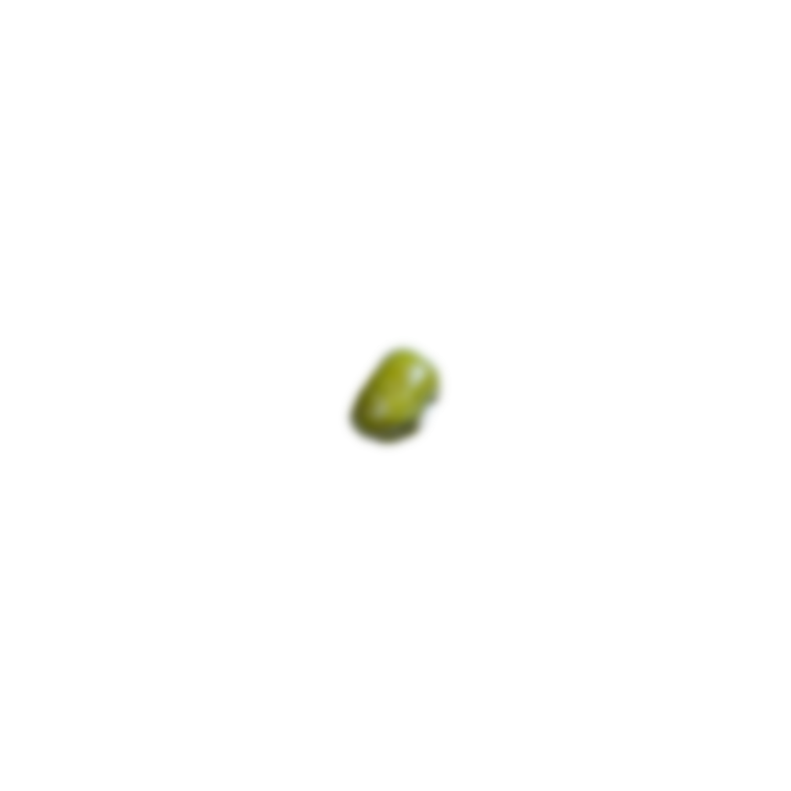
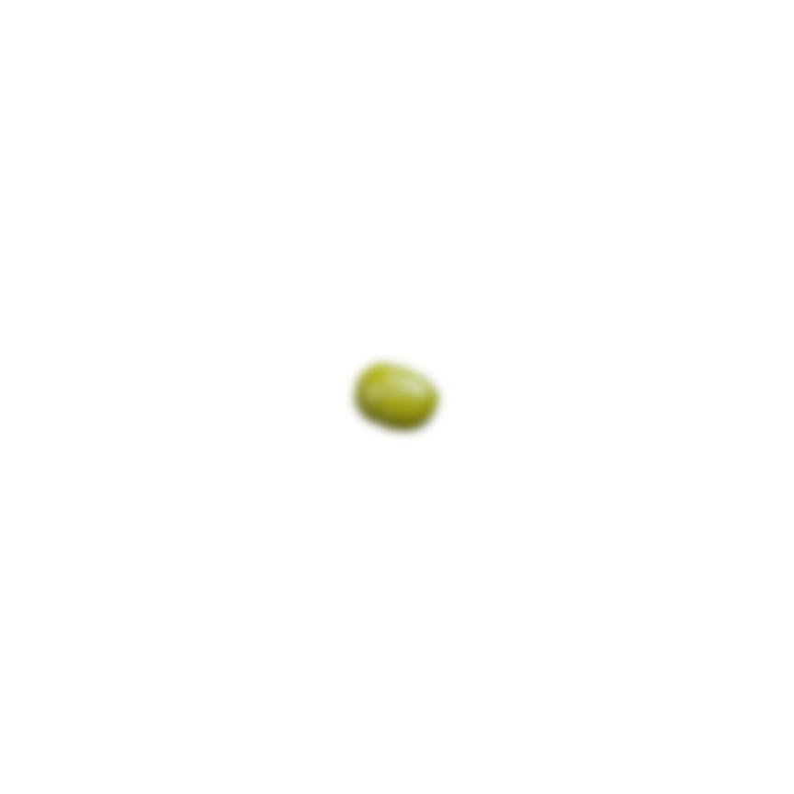
MONGODB

Slide 2
db means
database.

Slide 3
db means
database.
Yes, I store data!

Slide 4
let me manage your data, no brainer.

Slide 5
SQL
My data are interrelated through my tables. I love making connections!
NO-SQL
Tablesssssssssssssss? One folder is enough to put all my data

Slide 6
“
SQL
My data are interrelated through my tables and I love making relationships!
NO-SQL
Tablesssssssssssssss? One folder is enough to put all my data
Notes:
SQL similar to Google Sheets
Uses columns and rows
Tabs as Tables

Slide 7
SQL
My data are interrelated through my tables. I love making connections!
NO-SQL
Tablessssssssssss? Oh, please. One document is enough to put my data
“

Slide 8


Slide 9
DATABASE
mongoDB stores and manages data
NO-SQL
data are stored in documents
mongoDB

Slide 10
GUESS THE LOGO!
GUESS THE LOGO!
GUESS THE LOGO!
GUESS THE LOGO!

Slide 11



GUESS THE LOGO!
GUESS THE LOGO!
GUESS THE LOGO!
GUESS THE LOGO!

Slide 12
GUESS THE LOGO!
GUESS THE LOGO!
GUESS THE LOGO!
GUESS THE LOGO!
Notes:
Tinder

Slide 13
GUESS THE LOGO!
GUESS THE LOGO!
GUESS THE LOGO!
GUESS THE LOGO!
Notes:
Uber

Slide 14
GUESS THE LOGO!
GUESS THE LOGO!
GUESS THE LOGO!
GUESS THE LOGO!
Notes:
AirBnB

